Slide 1





Slide 2









Slide 3
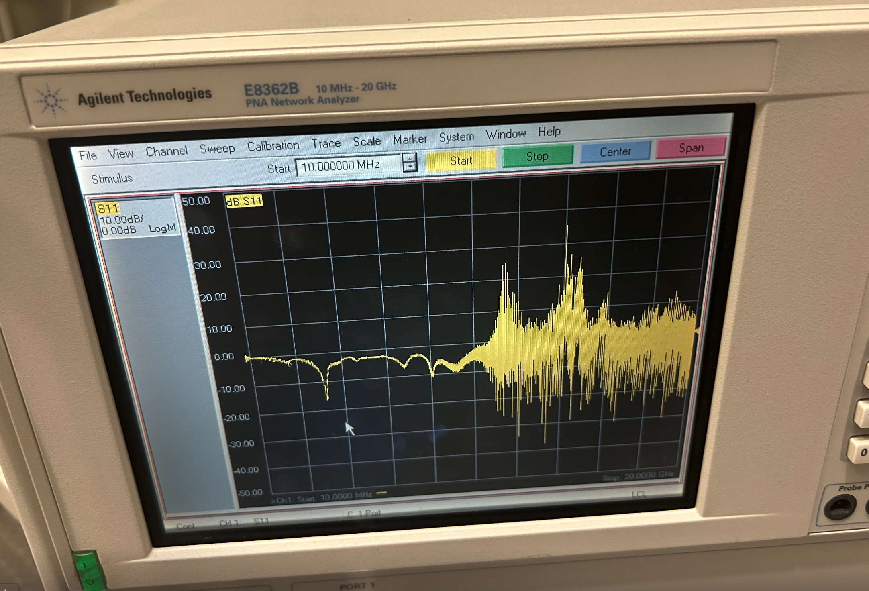
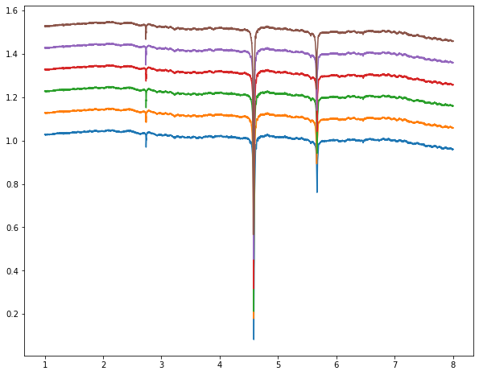


RT SOS- S11 (Dilfridge)
30 K SOS- S11 (probe station)
3.xG

